Slide 1
Design of a Robotic Vehicle for Placement of Situational Awareness Sensors
In Association With: Dan Jensen & Mickey Wright
Team Members: Nathan Phipps, Anthony Stehr, Erich Wanzek, Dat Nguyen, John Milner, Phi Nguyen, Semere Filmon, Jacob Zahorik, Ariel Lafuente (Team Lead)
Notes:
Hi, welcome to the CU Denver team participating in the Air Force Research Labs Design Competition. We are a team of six electrical engineers and three mechanical engineers. We are pleased to showcase the Design of Robotic vehicle for Placement of situational Awareness Sensors. My name is Ariel Lauente, a mechanical engineer. In this Competition we are tasked with placing sensors in hard to reach locations. In this presentation we will be showcasing the design and engineering used to achieve this task. To begin I will be start us off with our design method.

Slide 2
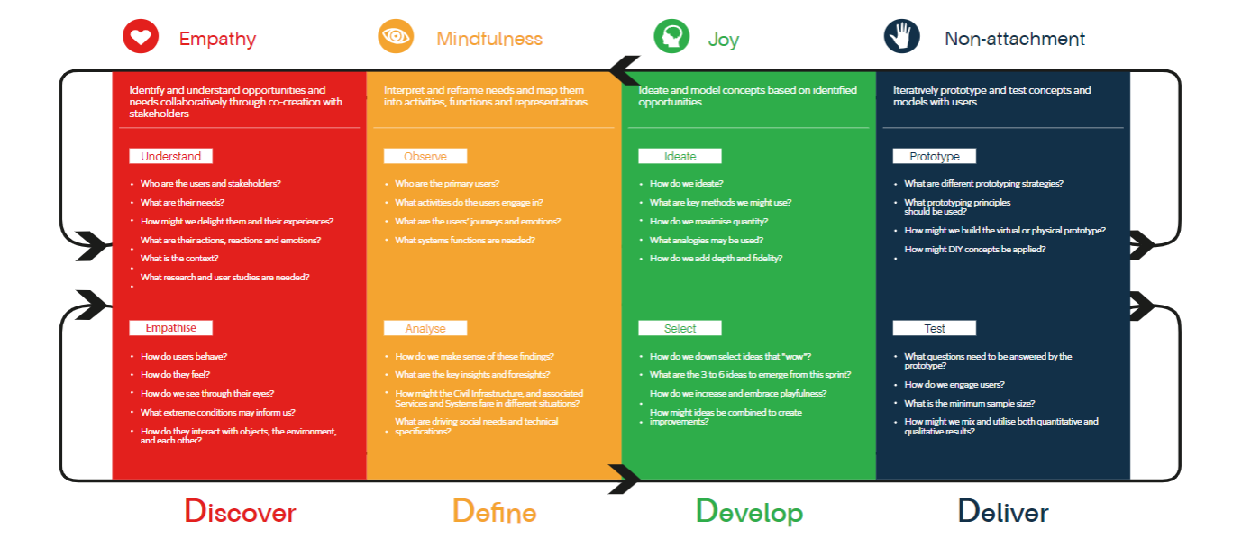
Discover, Define, Develop & Deliver
D1 Discover: Understanding Customer needs. Gaining insights that may reveal new ways of solving a problem.
D2 Define: Reframing the perceived problem or challenge at hand and gaining perspective through divergent styles of thinking to explore as many possibilities to encourage maximum numbers of ideas and points of view
D3 Develop: Ideate and model concepts based on identified opportunities
D4 Deliver: Results from prototyping
Notes:
We followed the design innovation method under the guidance of Dr. Dan Jensen for this project. The Design Innovation method is a method that consists of a 4 phase procedure that allows for the optimization of the design project. In the first phase, Discover, The team gained insight on the task at hand through identifying stakeholders and subject matter experts, identifying critical questions, conducting interviews, and finally by creating scenarios. In the second phase, define, all key insights learned from the previous phase were then refined by reframing the perceived problems to gain additional perspective on the challenge at hand. In the third phase, develop, the team then began generating ideas based off the information learned from the first two phases. Finally, for the rest of this presentation, I am very excited to show the team’s deliverables from the deliver phase where we decided to choose our absolute best solutions for the challenge..

Slide 3
Overview:
Importance: This system aims to provide ease in allowing for object/system placement and deployment to specific locations that might otherwise be difficult to reach. This system has use cases in surveillance systems, covert object placement, multi-terrain traversal, and sensor/signal communications.
System Breakdown:
Rover
Drone
Sensor Package
Deployment of sensor package
Sticky projectile
Adhesive bonding of sensor package
Data Communications and Signal Handling
Sending/receiving video feed (functional prototype)
Processing incoming and outbound data, such as sending gimbal signal (functional prototype).
Tether System
Notes:
- Nathan
Our project was designed with the task of placing a sensor at a height up to 100 feet. The importance of this project stems from providing ease in remote object placement with additional applications in surveillance systems, multi-terrain traversal, and sensor/signal communications. Our final system is currently broken down into a variety of subsystems. These subsystems include a rover for travelling across ground terrain. Next we have a drone system for achieving an elevation of up to 100 feet.
Then we have a sensor package system which includes sensor components, such as cameras, antennas and a transmitter for transmitting data. Additionally we have a sensor deployment system for launching our sensor package in order to achieve desired placement. From here there is an additional subsystem for adhesive bonding or sticking of the package to a particular surface. Another subsystem includes data communications or signal handling for transmitting and receiving data from control systems. These data communications systems include the control systems implemented in the rover and drone, as well as the transmission and reception of data from other functions including the launching mechanism, and video sensor systems. Lastly we have a tether system which connects the drone system to the ground vehicle system. Again, each of these systems has been developed with the overall goal of deploying a sensor at a desired location including an area up to 100 feet, with a bonus objective for retrieving the sensor system.

Slide 4
Design for Function of High Importance
Navigating to the approximate location for the sensor placement.
Placing the sensor to the designated location, precisely.
Planting and securing the sensor at the desired location.
Data communication and data gathering.
Notes:
Our functional design that pertains to importance goes as follows:
Navigating the rover within the area of interest to plant the sensor.
By utilizing the drone the height limitations can be overcome.
Next, with the pneumatic system can launch the sensor package to the desired target.
But utilizing wireless communications, the designated personnel can use the sensor cameras for live video feed from a safe distance of the danger zone.

Slide 5
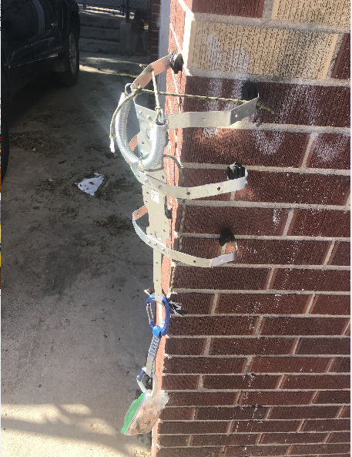
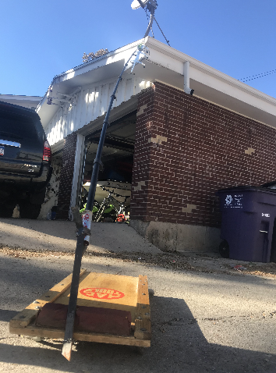
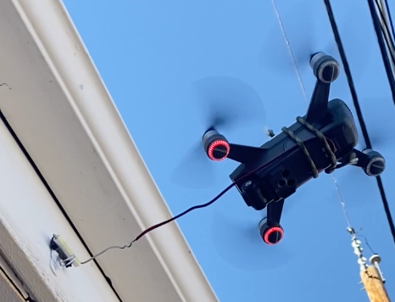
Deliver Phase: Prototyping Results
Spider Climber - piston actuated modular body design (top left)
Could carry heavy loads, but only worked on corners of a building
Boom Arm - extendable boom arm from ground vehicle (top right)
Could operate from ground but could not reach target distance
Drone - drone with extended arm that pressed sensor package against surface (bottom)
Easily reached target height but wasn't able to apply sufficient pressure
Notes:
With the aid of the Matrix Comparison Method, we were able to downselect the most promising designs to accomplish the task of sensor placement. We began with the spider Climber design with a piston actuated modular body that could scale the corner of a wall. This allowed for a large weight carrying capacity, but was only applicable when climbing a corner of a building. Next we experimented with using a boom arm. This design consisted of an arm that extended from a ground vehicle to place the sensor package. The major downside of this design that quickly became apparent was the large torque applied to the connection to the ground vehicle when fully extended. Our third method was flying a drone up to the target location and pressing the sensor package against a surface with an extended arm. The only disadvantage this design had was the lack of force we could apply to achieve adhesion to the target surface. After these 3 tests, we combined the idea of a ground vehicle from the boom design and a drone for placement of the sensor, but still required other critical components to be prototyped.

Slide 6
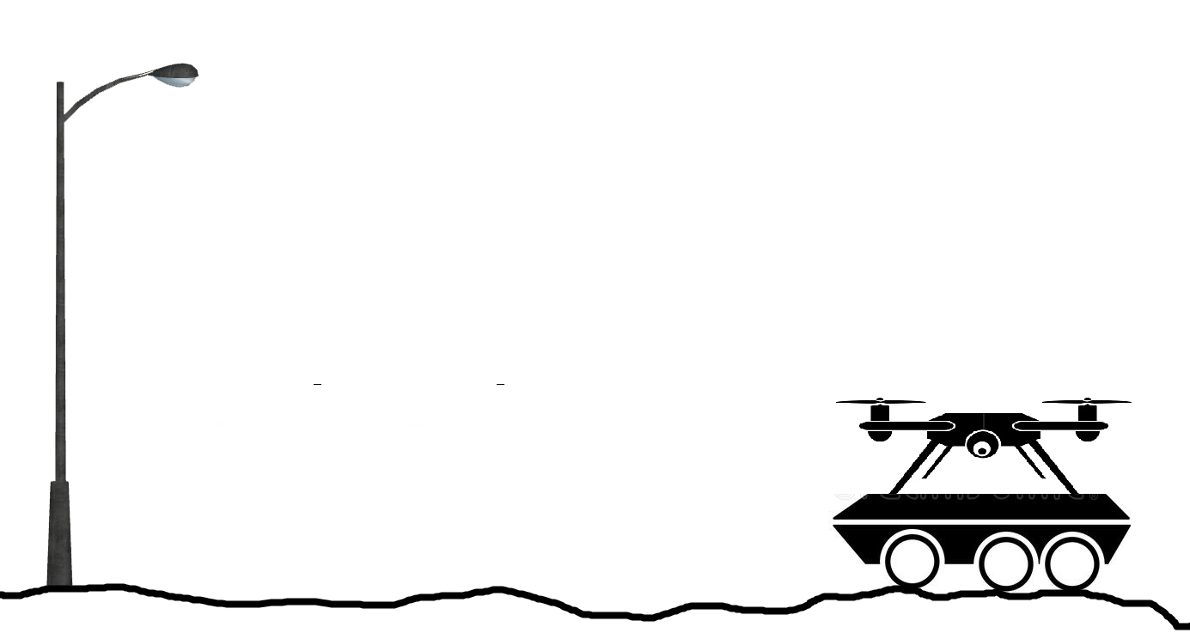
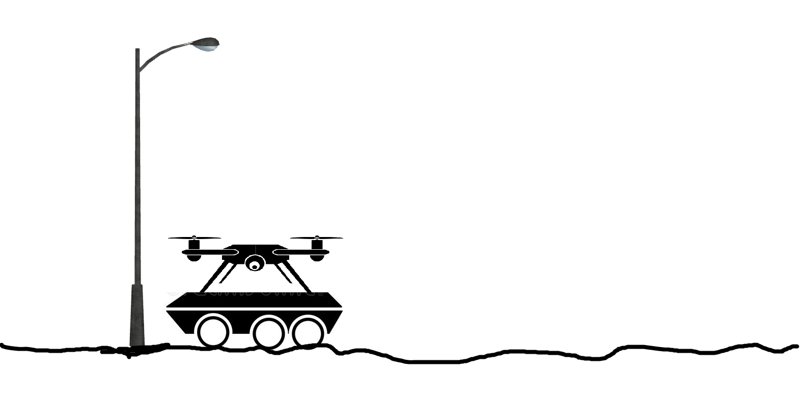
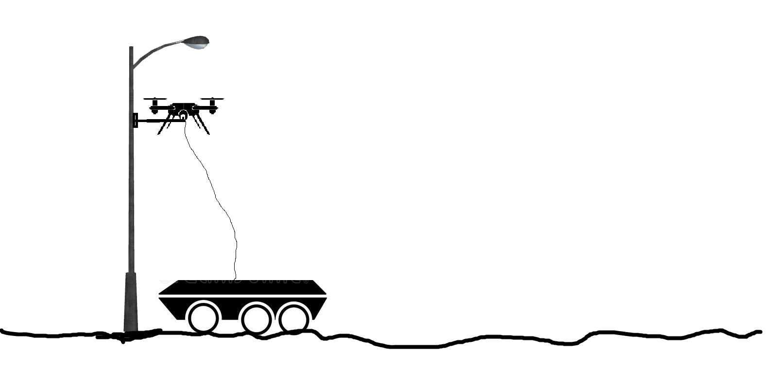
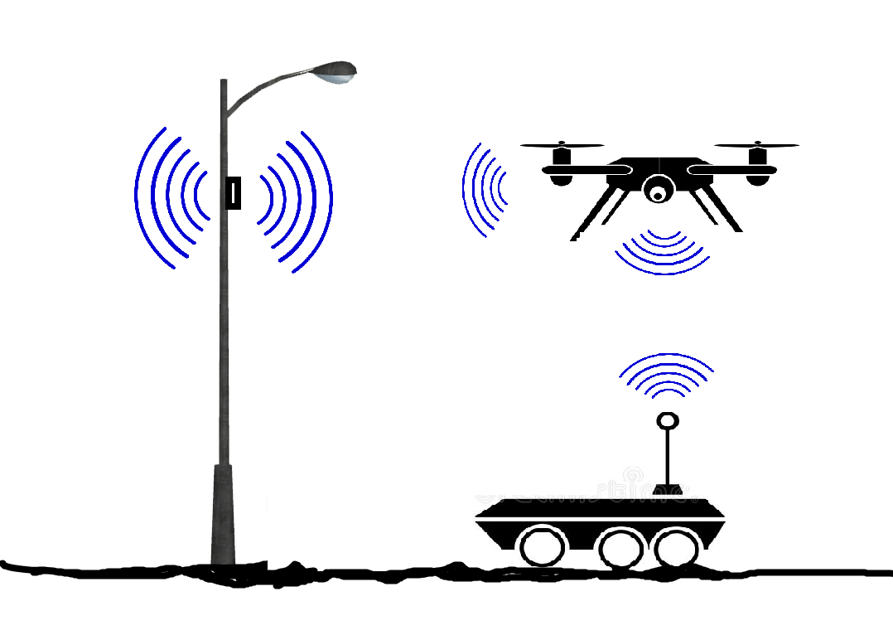
Design for Function of High Importance
Overall Robotic Vehicle System Operations:
Sensor Attachment and Deployment
Flying Drone for Vertical Ascension
Driving Main Vehicle
Data Communication and Remote Control of all Systems
Notes:
Erich
After the initial stage of prototyping, the team compiled and examined enough information to determine methods that contain the highest probability of success. Our final design consists of four main subsystems.
The four main subsystems are a ground rover, a drone, a sensor attachment device, and a base station which all together perform the functions of high importance of the system. The rover, which houses the drone on top of its frame and is connected to the rover with a tether, navigates to a location in close proximity to where the sensor needs to be placed. The drone, which carries the sensor attachment mechanism, then ascends to the required vertical height of the desired sensor placement location. The sensor package, which has a adhesive covered front-face and a rear mounted FPV camera, is then shot from the mechanism to the surface of the desired location.
Next slide

Slide 7
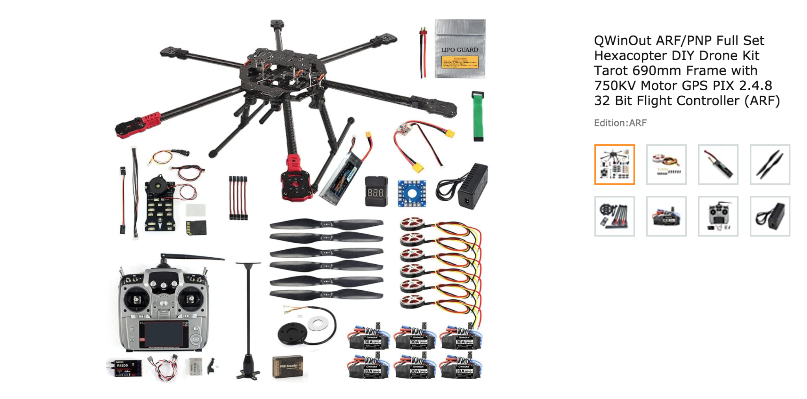
Final Product/Design: Drone
The final drone is HexaCopter, we use QWinOut ARF/PNP Full Set Hexacopter DIY Drone Kit Tarot 690mm Frame with 750KV Motor GPS PIX 2.4.8 32 Bit Flight Controller (ARF).
Why use this Drone?
6 motors provide enough power to carry the shooting mechanism and flight up to 100 ft as requested.
It is cheap compared with the other hexacopter on the market.
It is easy to replace the components if something gets broken.
It is bigger, so we have more space to set up the mechanism.
Notes:
We used the QuadCopter at the beginning to do some fly and load test. At the conclusion, we need to more power drone for the final. So, The final product is QwinOut ARF/PNP Hexacopter DIY drone. The reason we picked this drone because:
Hexacopter provides more power to carry the shooting mechanism and fly up to 100 ft.
It is cheaper compare with the other hexacopter on the market ( more than 3k )
It is easy to replace the components if break
4 . It is bigger, so we have more space to set up the mechanism.

Slide 8
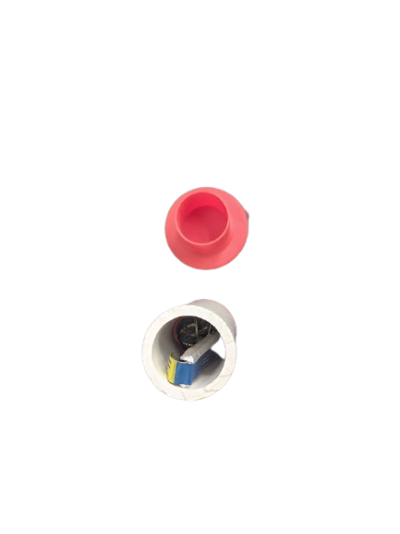
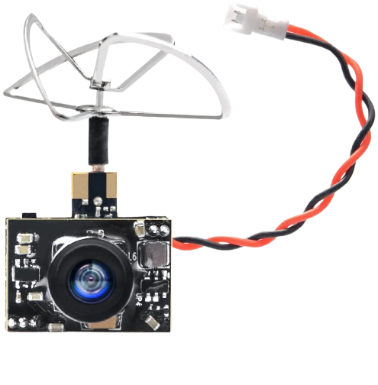
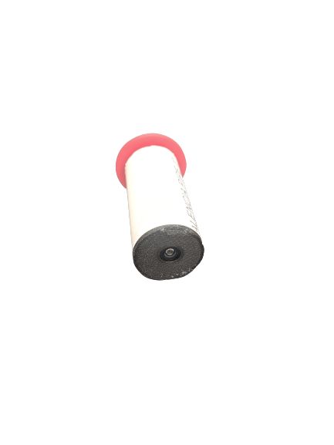

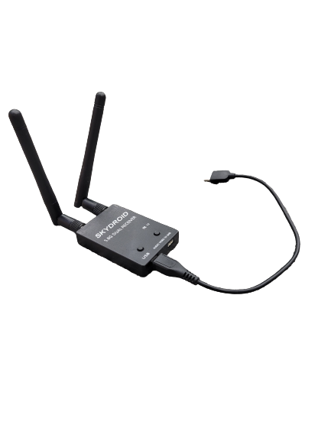
Final Product/Design: Sensor Package
Sensor Package’s parts:
Body: PVC tube
Cap : 3D printed using PLA
Sensor: FPV camera
Sensor’s power: 3.8 V battery
Camera’s receiver connect to a laptop
Notes:
Here we have our base model sensor package consisting of an FPV camera transmitter module and a 3.7V 200 milliamp hour lipo battery to power the system. This light weight design allows for a compact sensor package to be launched from the drone. The camera transmits to our skydroid receiver. This video data can be viewed either by a computer or an android device. Once the sensor package is deployed to the target location, a range of over 100 meters can be achieved from package to receiver. A PVC tube was used for the sensor package’s body because it is stronger than a 3D printed filament and has more momentum behind it allowing for a more straight trajectory. With this current base model, an hour of video transmission can be achieved.

Slide 9
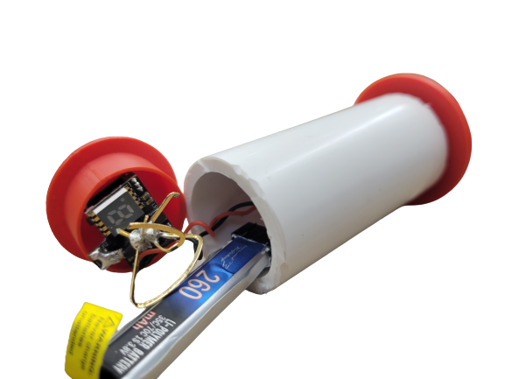
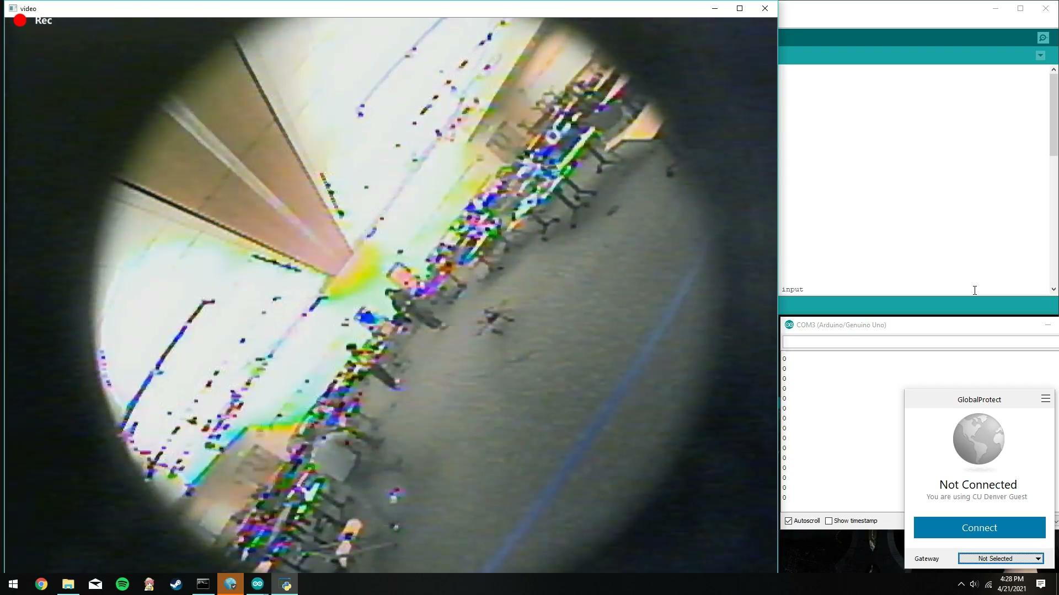
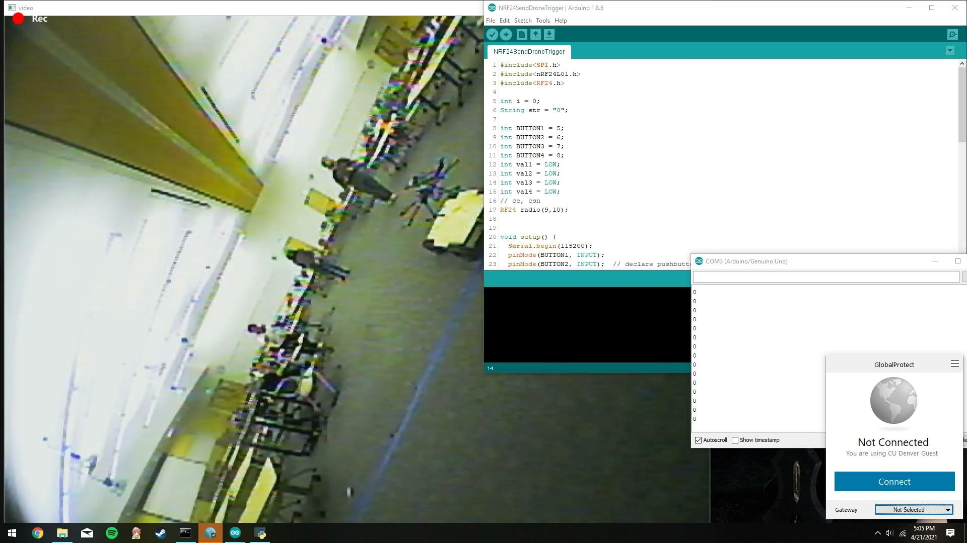
Final Product/Design: Sensor Package
Notes:
With this setup, there are certain limitations when keeping the design minimal. The first difficulty we dealt with was achieving a transmission distance over 100 meters. To extend this distance, a clover antenna was implemented in later iterations. This antenna configuration allows for a better transmission that extends the distance as well as transmitting with obstructions. Another difficulty was dealing with overheating of the FPV camera. Due to variances in production of these cameras, amounts of overheating varied between individual devices, so initial tests were conducted to determine which individual cameras performed with minimal overheating. Small fans were tested as an addition to the system, but did not reduce heat well enough to be worth the power use. Dealing with shock absorption was another hurdle for this design. When launching the sensor package at the wall or when a package doesn’t successfully adhere to the target location, a strong enough shock to the system can damage the sensitive FPV camera. Shock to the system can also cause the lipo battery to send a large charge through the device which has a high potential of damaging the FPV camera. Lipo batteries are also sensitive to force, so as to not damage the camera or battery, shock absorption was a worthwhile add to the sensor package. The final difficulty we faced was extending the battery life of the system. We worked with a larger 2000 milliamp hour 3.7V lipo battery that would greatly extend battery life, but due to size constraints, we proceeded with the smaller 200 mAh battery.

Slide 10
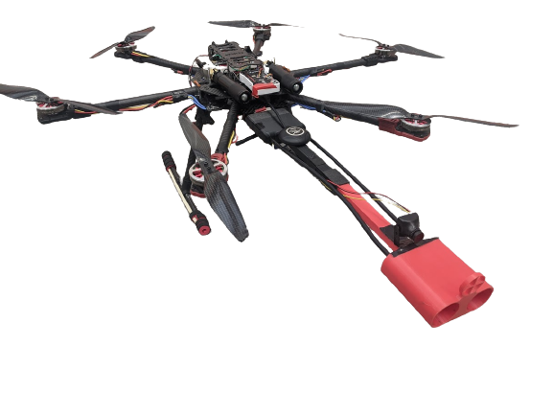
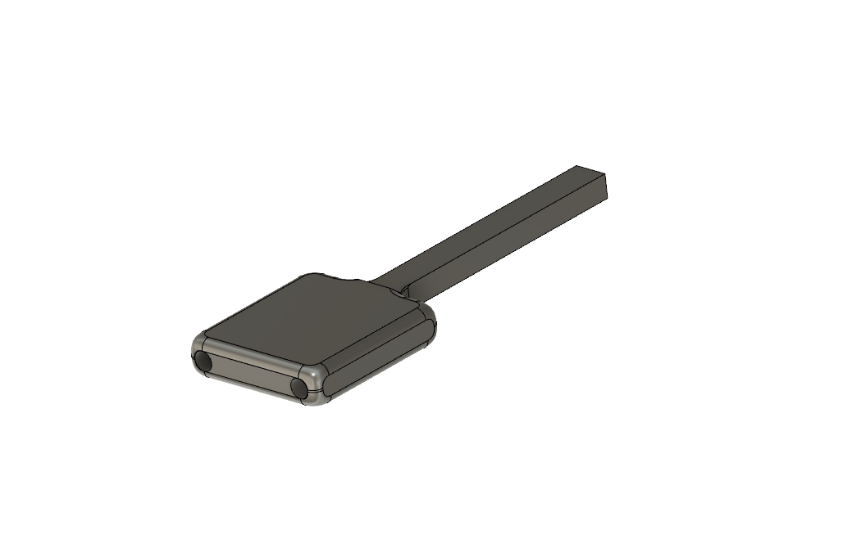
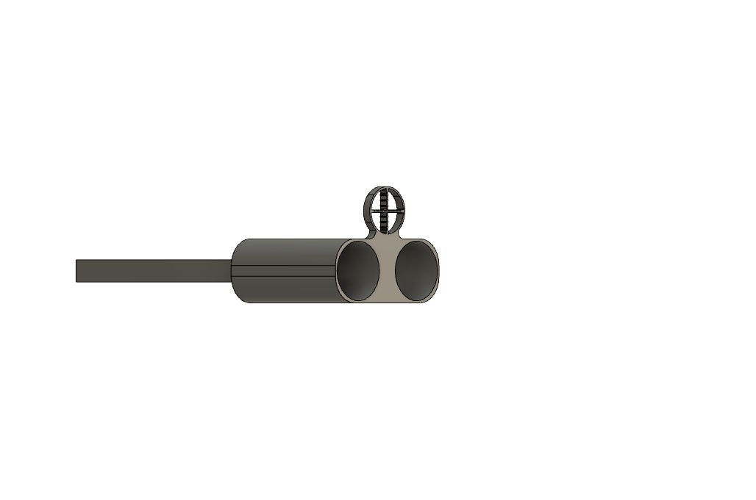
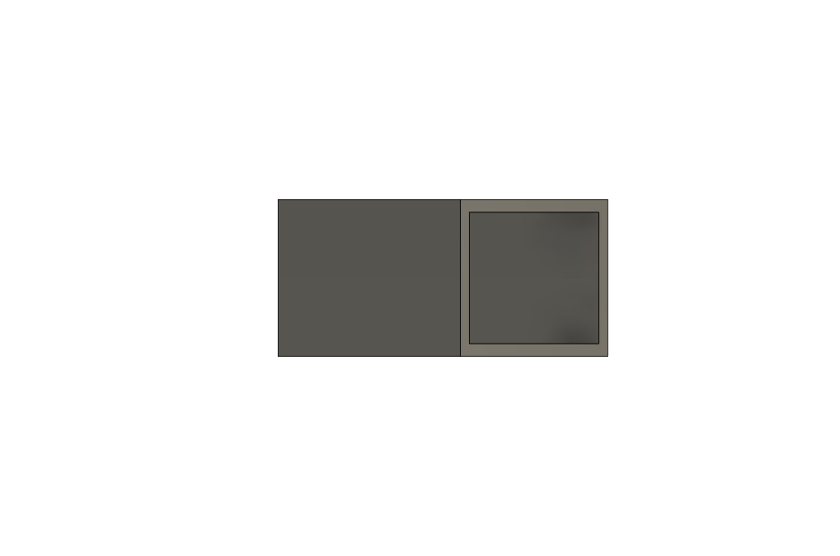
Final Product/Design: Launching Mechanism
CO2 Tank
Solenoid
Sensor Launching Frame
Sensor Package
Notes:
Attached to the drone is a pneumatic system to deploy our sensor. This consist of two canisters that holds 90 grams of Co2 which gives 850 psi. Paired with them, we have two 12 Volt electric solenoid valves that are rated to 1000 psi each. The barrels and arms were 3D printed with PLA filament. The canisters are connected to the barrels with a quarter inch tubing with various connectors. The arms extend the barrel 19 inches to be able to get the drone closer to the target, to mitigate the package from wobbling through the air while being deployed. The valves and canister were the heaviest part of the system weighing in at 200 grams each, so we designed it to be able to sit closer to the body help with the center of gravity of the entire drone. This helped stabilizing the drone while in flight. The valves are actuated from an Arduino circuit wirelessly.

Slide 11
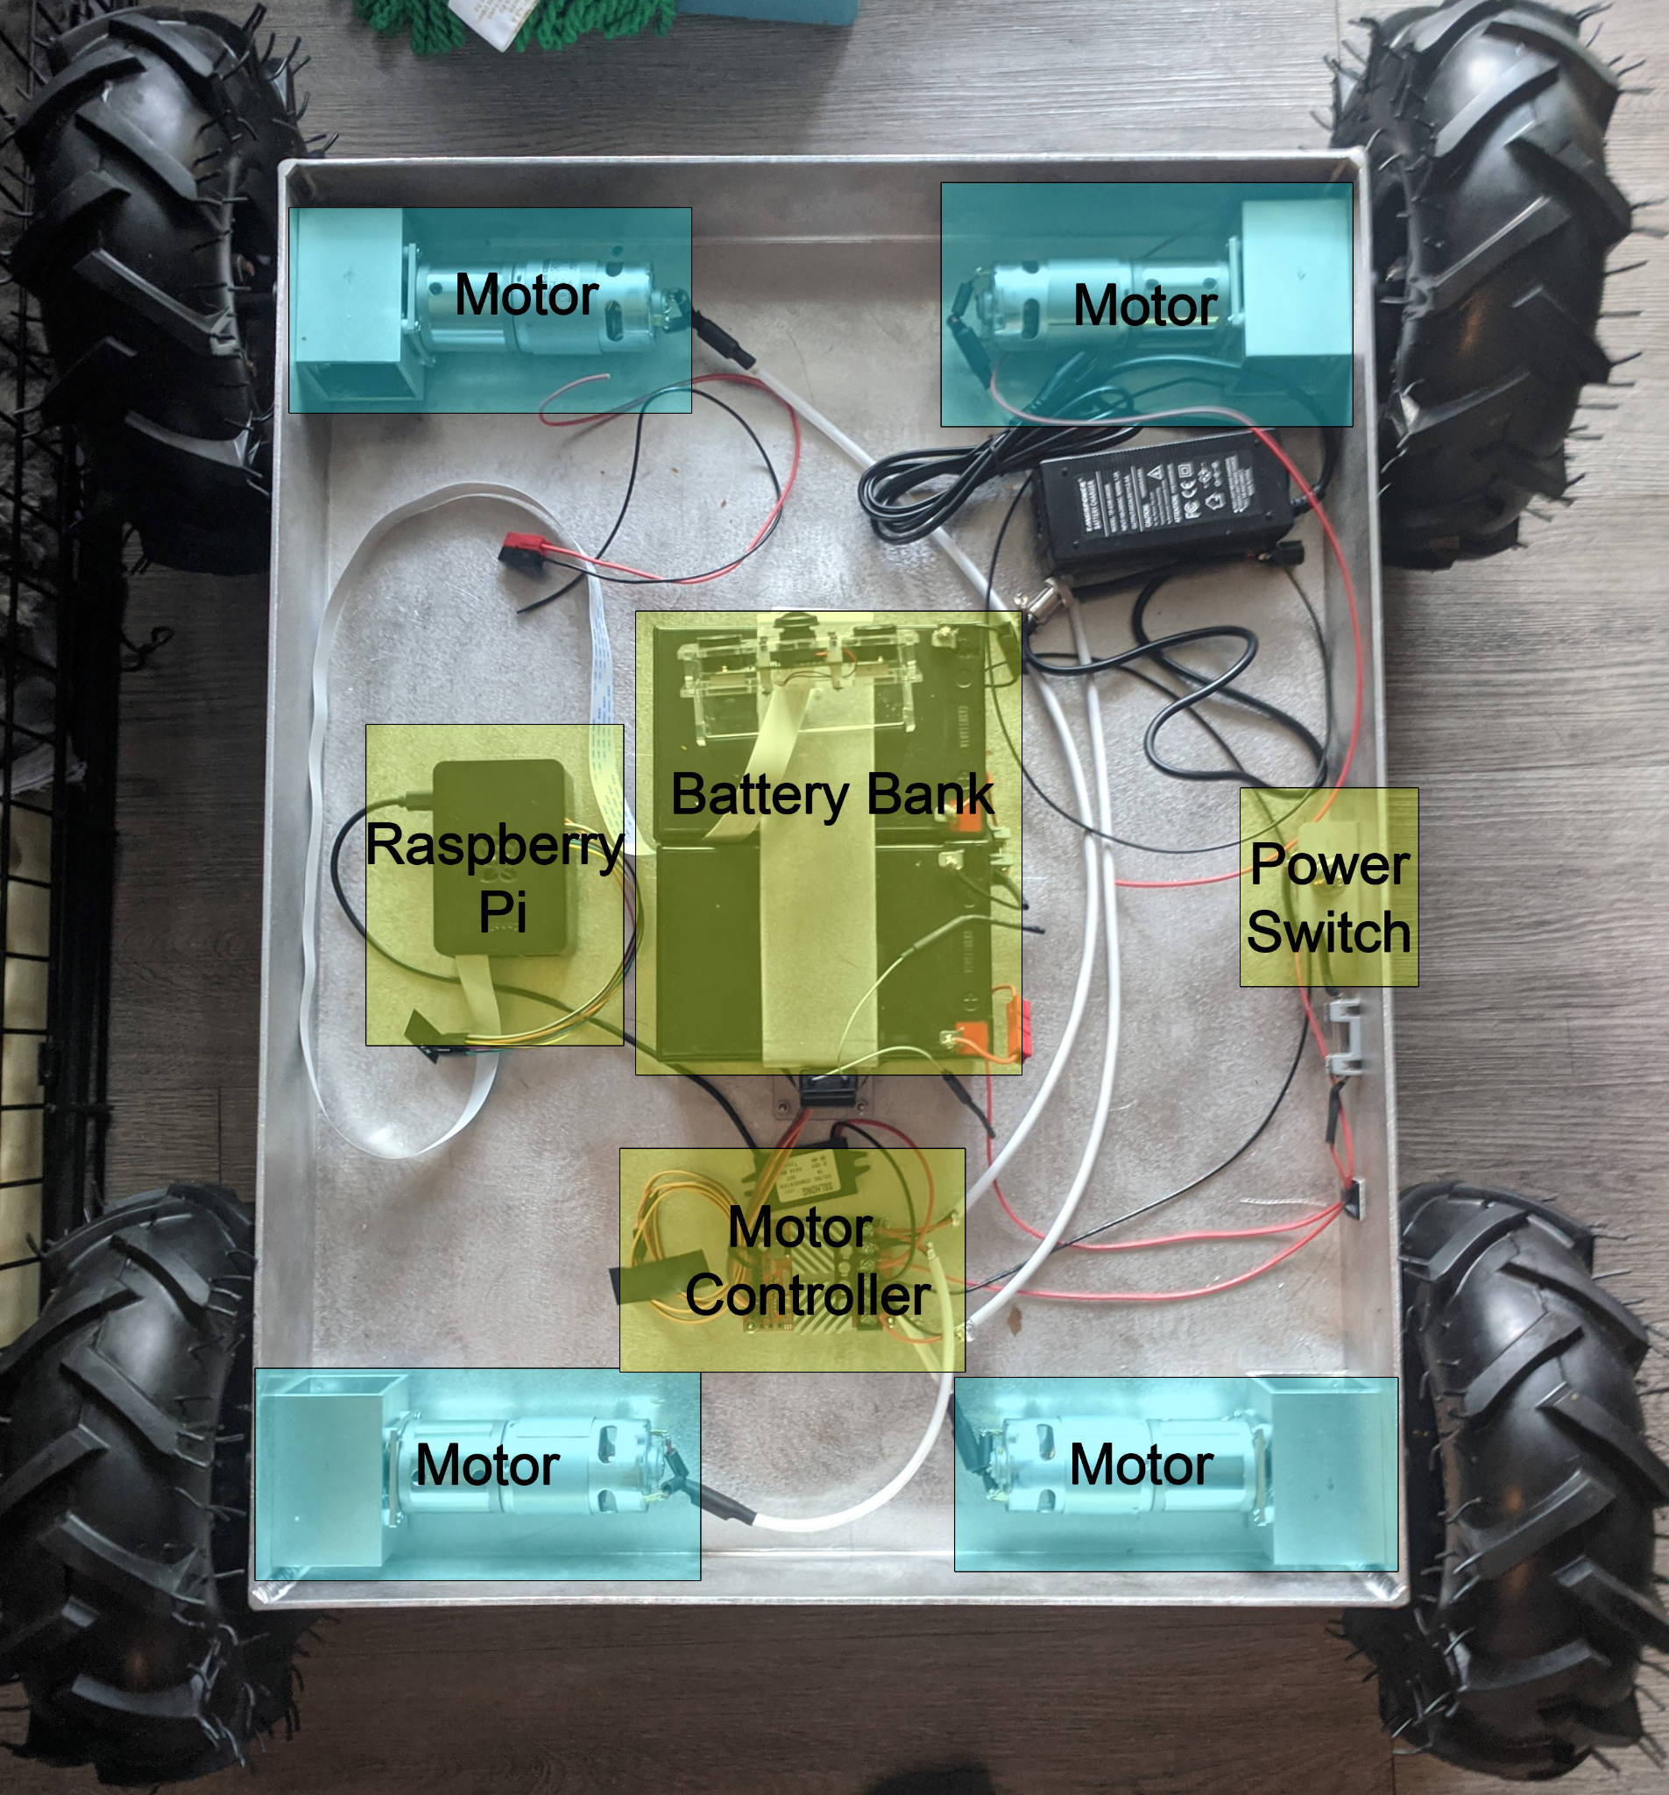
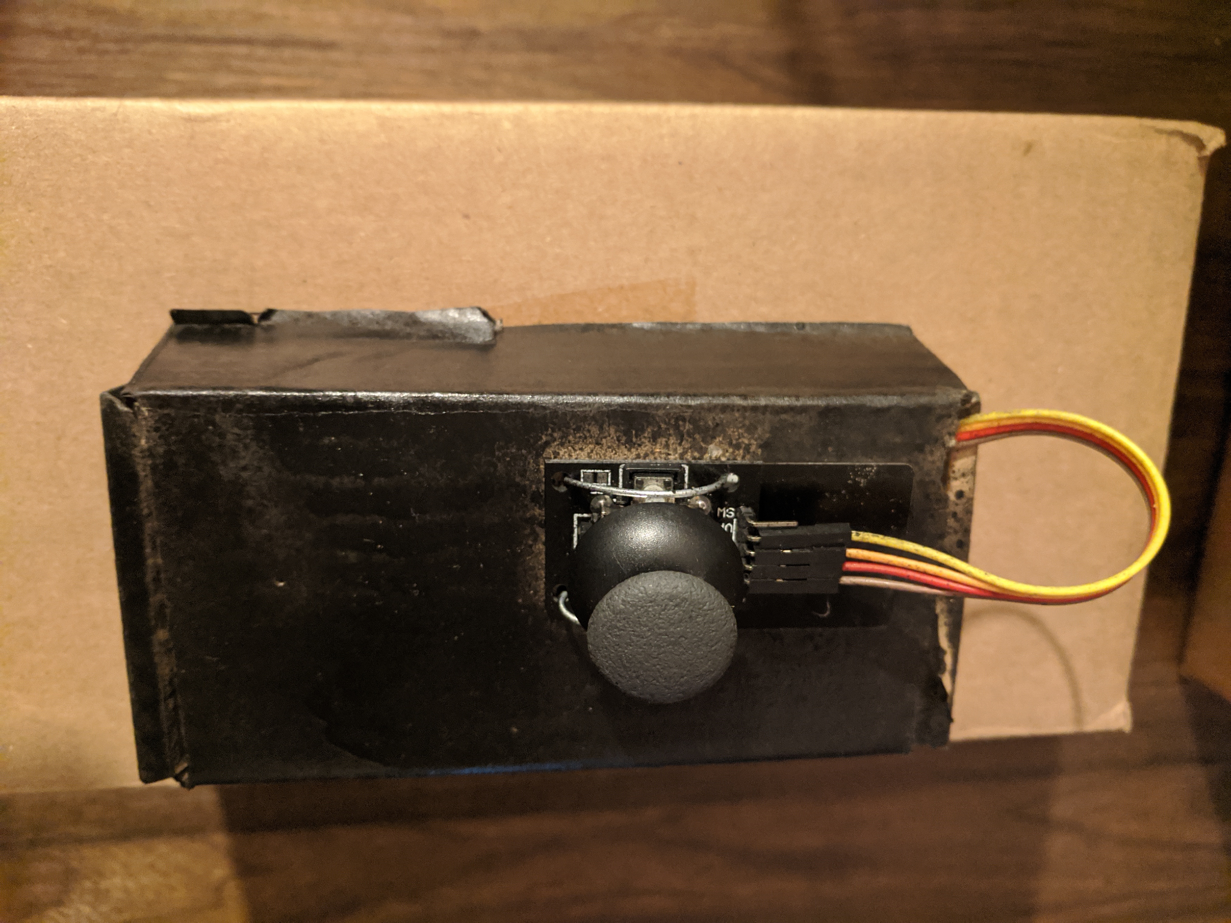
Final Product/Design: Rover
Details: Dimensions: 20x26 inches Weight: ~50 lbs. Payload Weight: ~40 lbs. Battery System: 24V 12Ah Computing Hardware: Raspberry Pi 2x30a Motor Controller Arduino Uno
Notes:
The main purpose of the rover vehicle is to transport the drone to and from its deployment location, saving the drones battery and allowing us to carry additional hardware for the mission ( such as on-board computer, tether system, batteries, gps). The decision to purchase a pre-built robotic vehicle chassis was made when we were able to locate a company that custom builds robot chassis that could fit our needs. The criteria we were looking to fill are as follows: size, weight, motor power, and payload. To assure the rover is able to carry all hardware, the largest available size of 20in x 26in for the frame was chosen. This size allows for us to carry the largest drone we planned to use as well as carry an additional 40 pounds.
The on-board motor controller allows for 30 amps to each set of motors continuously. Since some components of the system provided by the rover manufacturer are limited to 15 amps, We have capped the motor controller current draw to 12 amps. This still allows for enough power for the motors to climb over obstacles and operate as intended.
Each 12v battery has 12 amp-hours of charge and at idle conditions only the Raspberry Pi draws an average of 1 amp and max current draw is 3 amps. This combined with the motor demands, gives us a range of roughly 1.5-12 hours of operating time.
Purchasing this rover allowed us to utilize more of our time programming the controls for the motors as well as implement the wireless communications. The main controlling hardware is the Raspberry Pi, a low-cost, versatile computer which made data handling more efficient and effective due to its GPIO ports. These allow for easy integration of our NRF24L01 Transceivers and BN-880 GPS module. All information compiled through the Raspberry Pi can then be sent wirelessly to the Base Station.
To drive and operate the rover, a separate controller was designed using an Arduino Nano, NRF24 transceiver, and a simple analog joystick. This device allows for separate, independent control and can also act as a receiver for the ground station. Controls can also be offloaded to the base station computer if necessary.

Slide 12
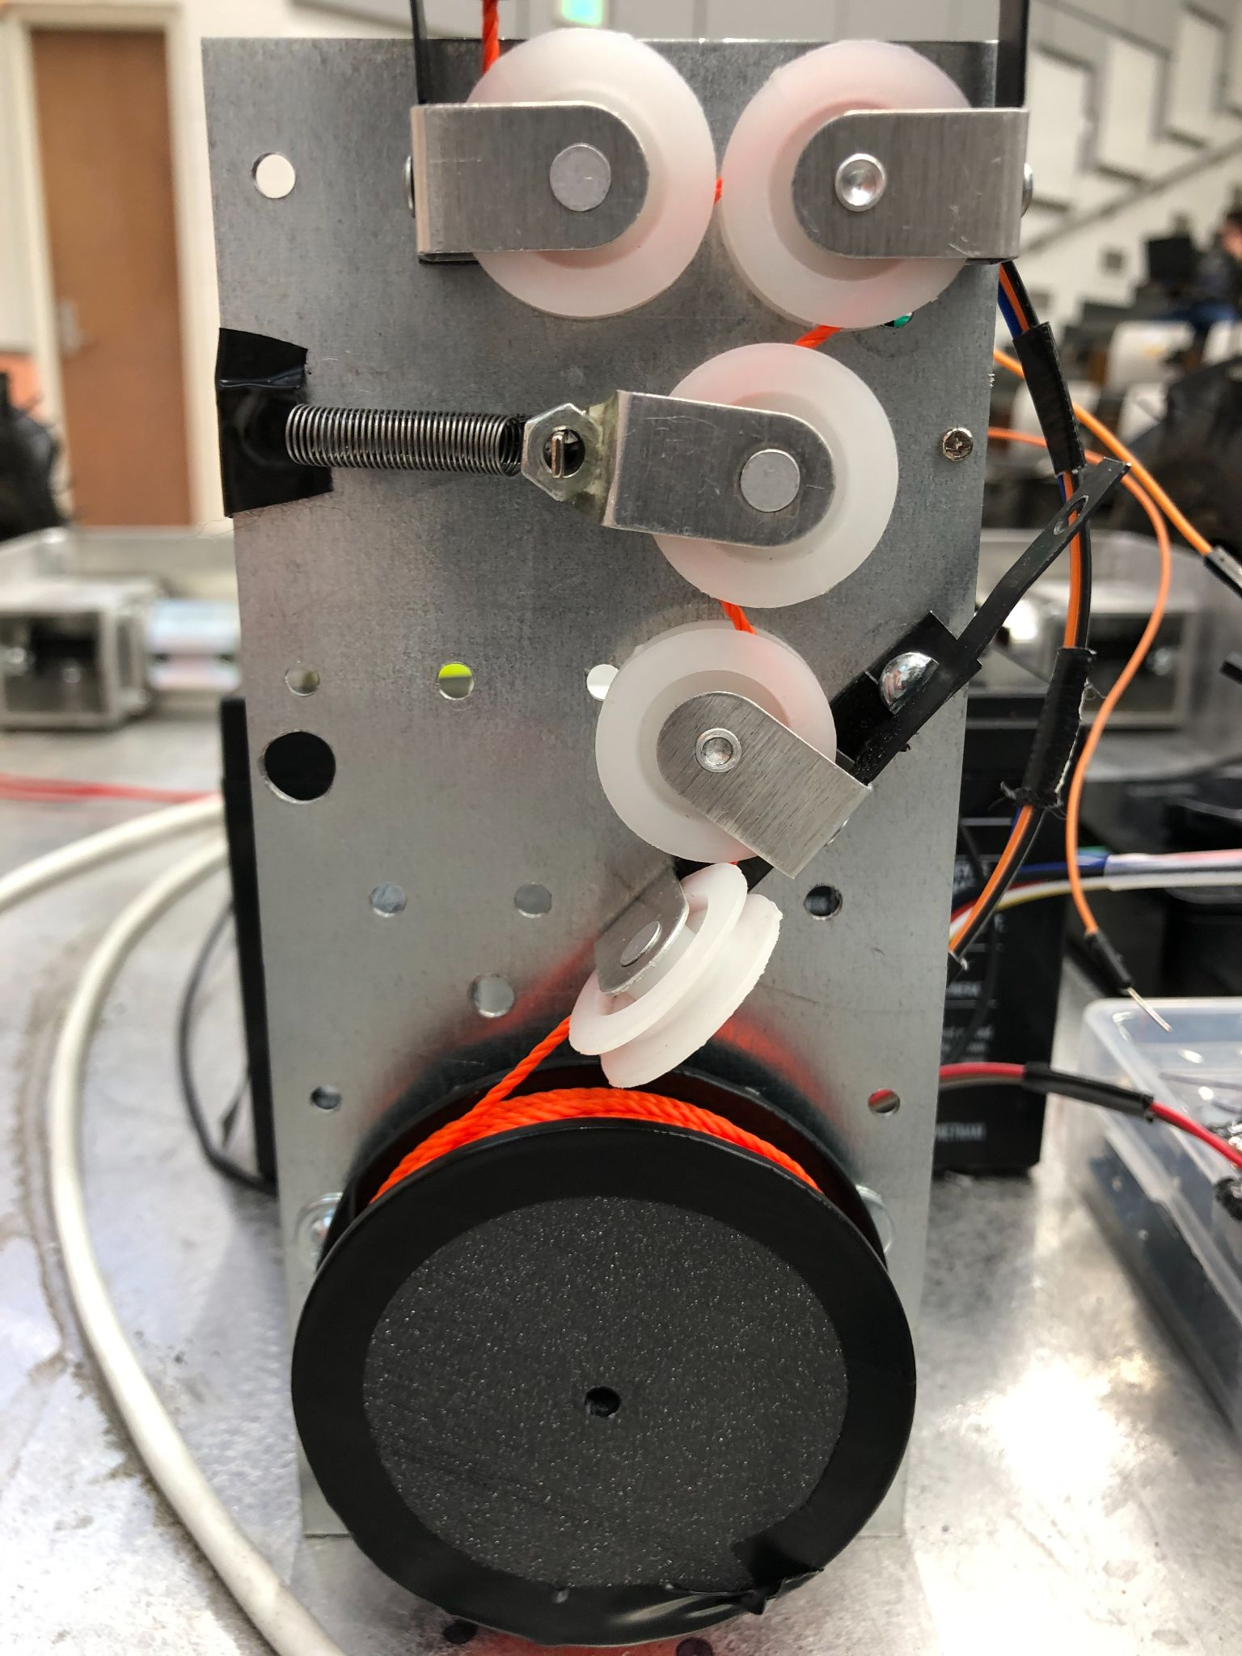
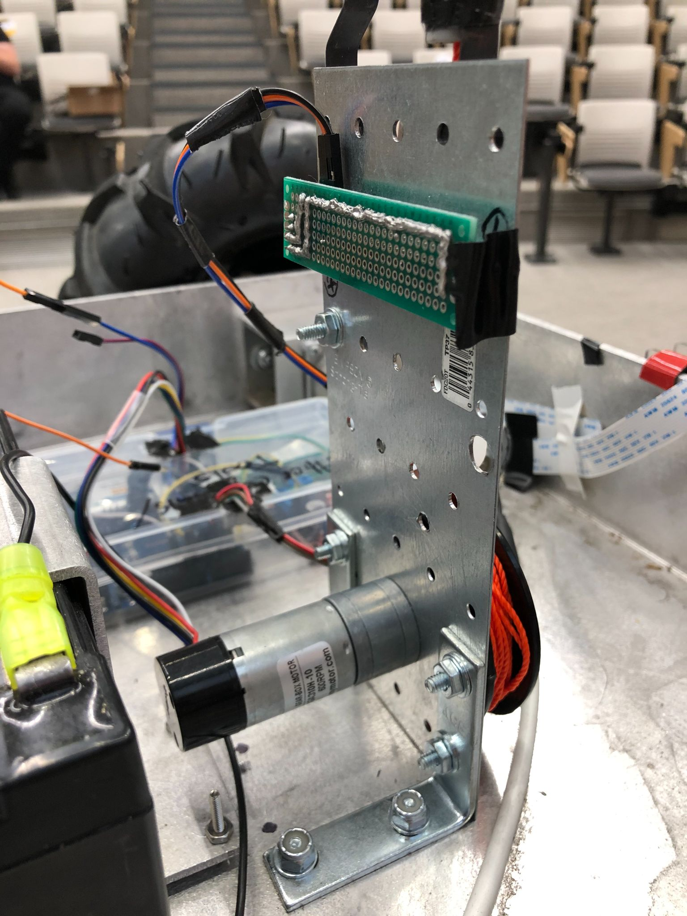
Tether System
The Tether serves as a robust mechanical link to the ground rover.
PID controller is used to maintain constant tension in the tether
Maintaining constant tether tension serves to regulate the amount of tether deployed and the rate of tether deployment
Notes:
The robotic system was designed to have the drone be tethered to the rover vehicle. This serves the purpose of having a direct mechanical attachment to the drone in the case of a system failure or for recovery capability after a drone failure. The tether system also serves as a proof of concept for possible future iterations involving a tether system consisting of a power transmission line and data transmission line to the drone allowing for enhanced capabilities such as extended flight time and a robust communication link to the drone.
The tether system consists of a tether spool attached to a 12 vdc motor and a pulley configuration consisting of a pulley on a spring loaded sliding potentionometer that measures the tension in the tether. A microcontroller continuously reads the tension of the tether. In order to control the tether tension to maintain the desired setpoint, an embedded PID controller continuously reads the tension value and sends a command signal to the tether spool motor to adjust the tension.This control system allows for the correct amount of tether to be deployed at the correct rate as the drone maneuvers to the desired location for sensor placement.
The tether system mechanism consists of an confugartino of guiding pulleys to route the tether line and a linear pulley dancer configuration, consisting of two fixed pulleys and one free moving pulley on a liner track which is connected directly to a spring loaded sliding potentiometer. The dancer pulley moves to a position which is proportional to the tension in the tether system by moving to the position at which the force exerted by the tension spring and the tension force exerted by the tether line on the dancer pulley are equal. This equilibrium position is measured by a sliding potentiometer and the analog signal from the potentiometer is sampled by the ADC on an Arduino microcontroller which is then fed into the PID control.

Slide 13
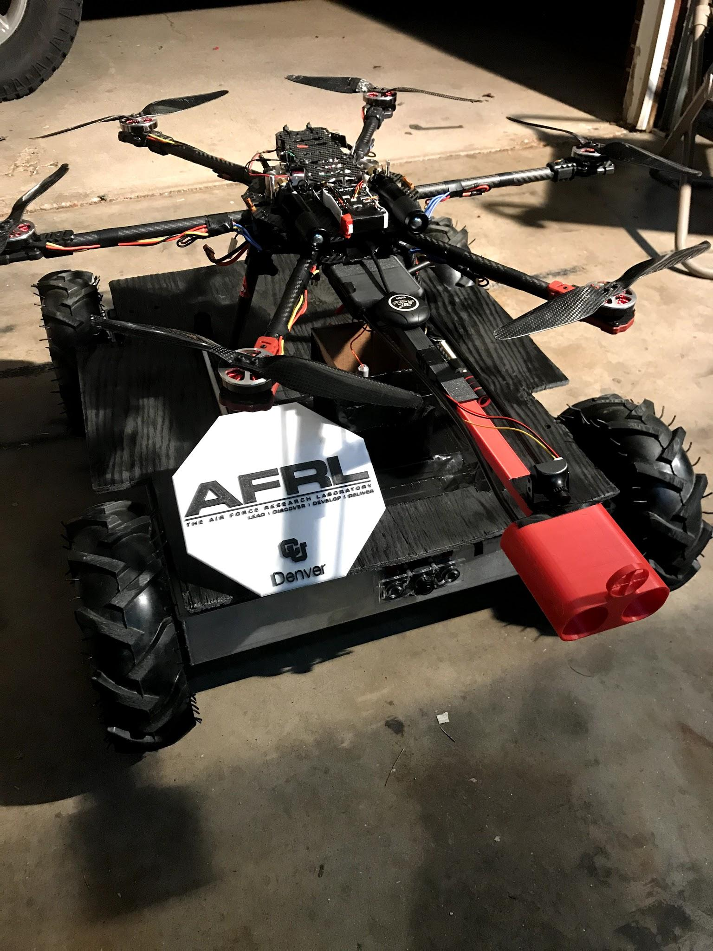
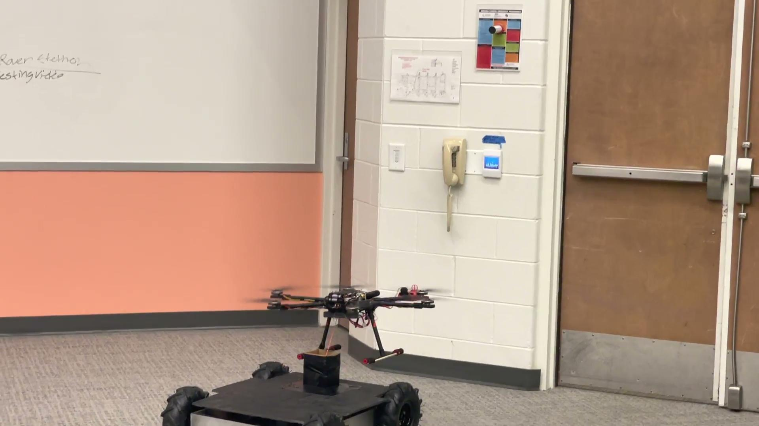

Final Product/Design: Full System Testing
Fully Integrated Sensor Deployment System
Notes:
Now, I would like to present the CU Denver team’s Final product

Slide 14
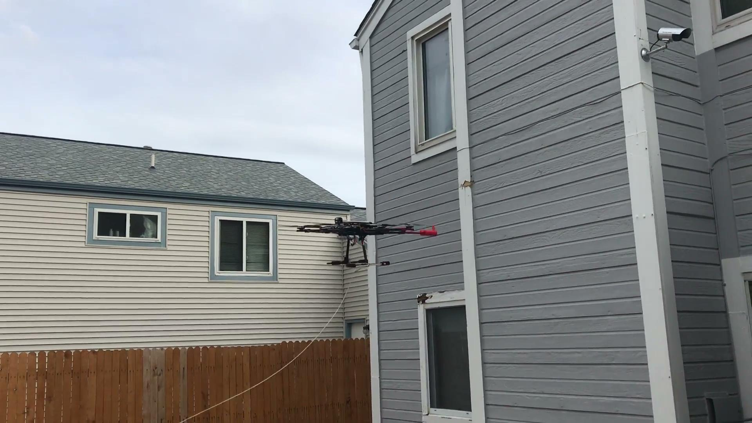
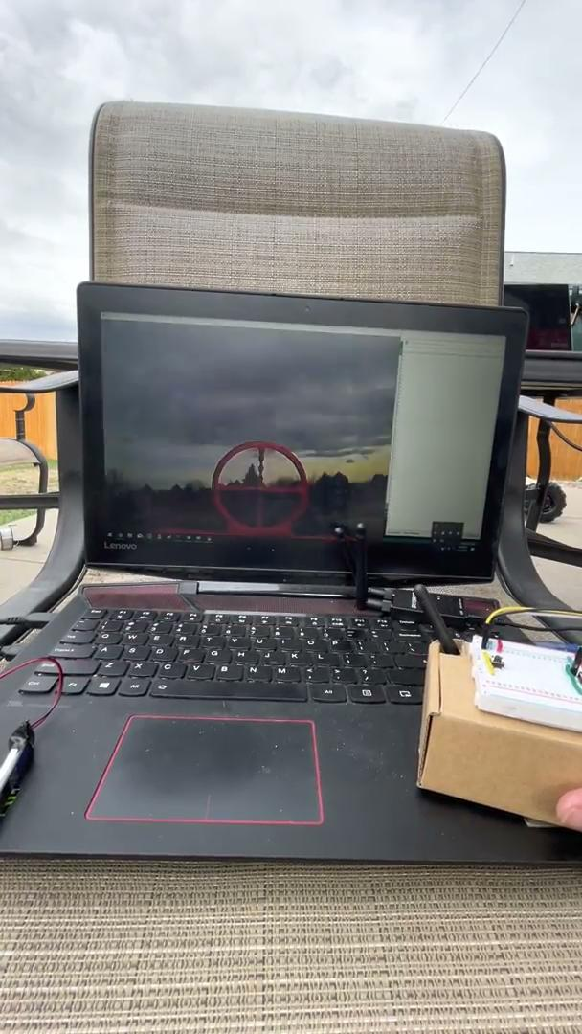
Final Product/Design: Additional Full System Testing

Slide 15
Budget Overview
Mechanical Engineering Department: $1342.43
Electrical Engineering Department: $1215.44
AFRL Funds: $3783.25
Total: $6341.12
Notes:
Over the course of nine months, we have spent $6341.12 for research and development of our system. Each resource was from the following:
Mechanical Engineering Department: $1342.43
Electrical Engineering Department: 1215.44
AFRL Funds: $3783.25
Total: $6341.12

Slide 16
Acknowledgements
Faculty: Dana Carpenter, Ronald Rorrer, Dan Connors, & Daniel Jensen
Stakeholders: Daniel Goldwin, Joshua Cogan, Benjamin Hickey, Greg Brockmeier, Sean Collins, Michael Phibbs, Alex Gracia, Jonathan Scott, Brad Grane, & David Ellis
Sponsors: Air Force Research Lab (Mickey Wright, Dr. Alok Das, & Mr. Mike Lazalier) & University of Colorado Denver
Notes:
We would like to thank our faculty, stakeholders, and sponsors for their support in assisting our team.

Slide 17
Questions?
Notes:
Questions?

